Slide 1
UNIT 5 SOLID STATE PHYSICS
Lecture 6

Slide 2




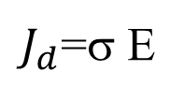
CLASSICAL THEORY FOR METALS
Free electron gas
Drude - Lorentz theory.. Used classical kinetic theory of gas to electrons in metal and Maxwell-Boltzmann statistics
Ohms law
$J_{d}$=σ E
Fourier’s law
Wiedemann –Franz law K/σ =const
And you know now
Drift current: Current flow by the application of the electric field ( field distribution)
Diffusion current: Current flow due to the variation in the charge distribution
Remember: Drude considered free electron concept with kinetic theory of gases (1900) and Lorentz applied Maxwell-Boltzmann statistics (1905).

Slide 3
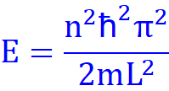
QUANTUM THEORY OF METALS
Free electron Fermi gas
Sommerfeld was behind it. Used Schrödinger wave mechanics and Fermi-Dirac statistics. This great person was nominated for Nobel prize for 84 times but never got it.. But many of his students got it. Good professor☺
The energy levels of the conduction electrons are quantized.
Electrons gets arranged as per Pauli exclusion principle
Fermi-Dirac statistics
Kinetic energy of the electron is quantized.. Analogous to particle in a box
Known as Drude-Sommerfeld model: classical concept of free electron considered with quantum mechanics+ Pauli exclusion principle+Fermi Dirac statistics
Now we got the idea about Fermi energy or Fermi level of metals

Slide 4
Classical and quantum free electron theory
Classical free electron theory enlighten us
Quantum free electron theory: Valance electrons to conduction electrons
Temperature dependence of thermal and electrical conductivity explained
Spin took care of paramagnetism- one of the quantum state
BUT BOTH FAILED TO EXPLAIN
Ferromagnetism in metals
Why some materials are Metal, insulator and semiconductors?
And the Hall effect – ± Hall coefficient (R_{H})
This all explained at the third stage of development BAND THEORY OF SOLID
Developed by BLOCH (obtained the solution for Schrödinger equation), KRONING-PENNEY (simplified the potential function) … This is what we learned in the third lecture

Slide 5
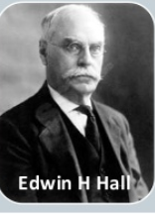
HALL EFFECT AND ITS APPLICATIONS
It was discovered by Edwin Herbert Hall in 1879 while while working on his doctoral thesis in Physics
Observed much before the discovery of electron!. However, could not be explained by the Classical free electron theory (1900) and Quantum free electron theory (1928).
Positive and negative value of Hall coefficient. Band theory of solids explained this phenomena!!
Hall coefficient
Hall voltage
Applications of Hall effect
1855- 1938

Slide 6
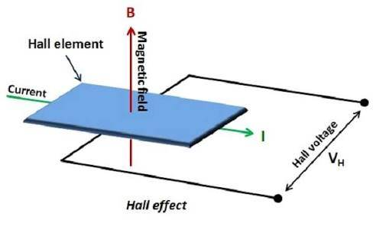
Hall effect
The Hall effect is the production of a voltage (the Hall voltage) across an electrical conductor, transverse to an electric current in the conductor and to an applied magnetic field perpendicular to the current. Combined effect of Electric field and magnetic field on the flow of charges

Slide 7
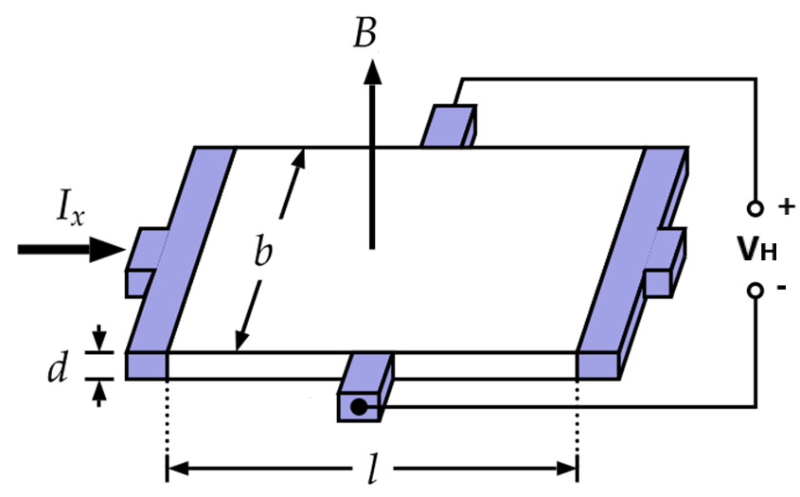






HALL COEFFICIENT AND HALL VOLTAGE
Derivation--
Force on the charge carriers due to the produced Hall electric field (E_{H}) is given by
Eq.1
Force on the charge carriers due to the applied magnetic field (B) is given by
Eq.2
Where v_{d} is the drift velocity and q is the electric charge of the carrier.
At equilibrium/stationary state these two forces must be equal, so from Eq.1 and Eq.2 we get
Eq.3
If we talk about the magnitude Eq.3 can be written as
Eq.4
In the present case θ is 90°, so we get

Slide 8


Slide 9





Consider n is the number of charge carriers per unit volume, then the current density can written in terms of the drift velocity (v_{d}) as follows
Eq.5
Substitute Eq.5 in Eq.4
Eq.6a
If b is the width of the block, then hall electric field E_{H} can be related potential as
V_{H} is known as the hall voltage and written as
Eq.6
Coefficient of proportionality 1/nq is called the Hall coefficient and is denoted by R_{H}. So we have
Eq.7
R_{H} will be negative if the charge carriers are electrons and will be positive if the charge carriers are holes. So can be used to distinguish the type of semiconductors

Slide 10



To relate the Hall electric field (E_{H}) to the applied electric field (E_{x}) we use the relation for J, in
Where are σ and ρ are the electrical conductivity and resistivity, respectively of the slab under consideration
Eq.8
So can be used as an electric and magnetic field sensors. Also can be used to measure the resistivity and conductivity of the semiconductors/materials

Slide 11
APPLICATIONS OF HALL EFFECT
To determine the resistivity and conductivity of semiconductors
To determine the Type of Semiconductors
To calculate the Carrier Concentration
To determine the Mobility (Hall Mobility)
To measure Magnetic Flux Density
Commercially available devices
Position and motion sensors
IC switch
GPS
Fuel injector
Sensors to detect rotation speed
In the presence of large magnetic field strength and low temperature, one can observe the quantum Hall effect, which is the quantization of the Hall resistance. This is now the official standard for electrical resistance.

Slide 12

If the current flowing through the semiconductor slab along its length with an applied magnetic field along its thickness, Hall voltage developed is due to accumulation of charge carriers
(a) Along opposite edges of its thickness
(b) Along opposite edges of its width
(c) Along opposite edges of its length
(d) Along the ends from where current enters
Ans: B

Slide 13
Hall effect can be used to measure
(a) Mobility of semiconductors.
(b) Conductivity of semiconductors.
(c) Resistivity of semiconductors.
(d) All of these
Ans: D

Slide 14
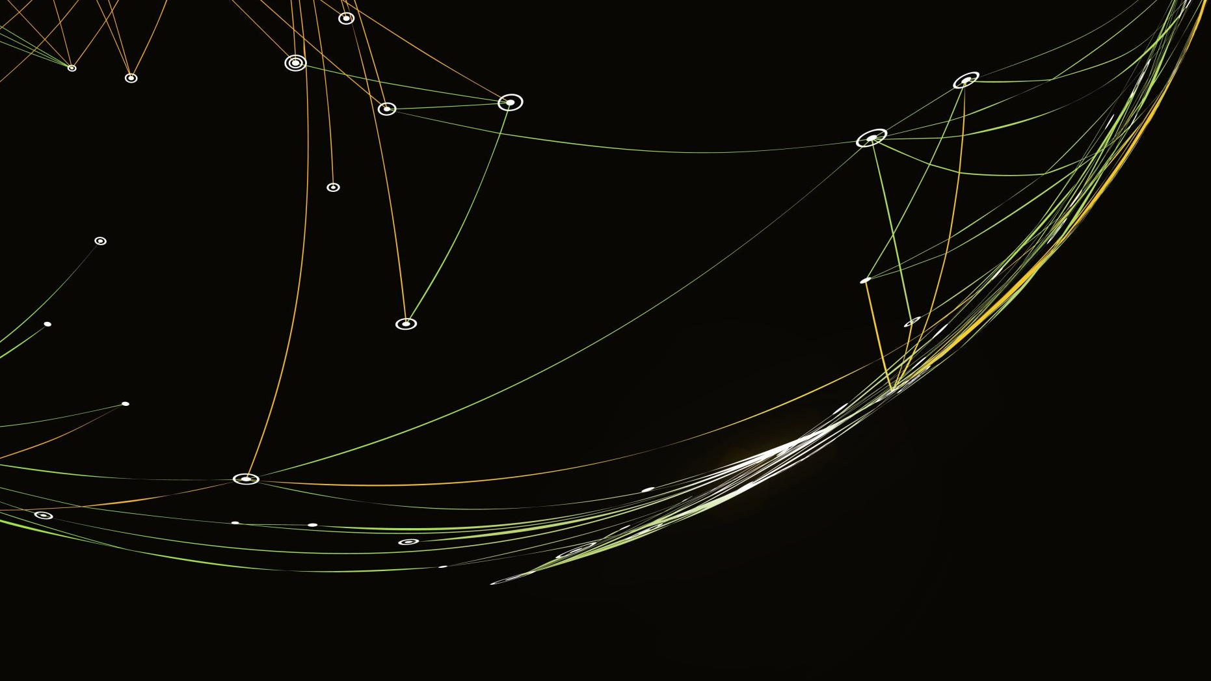
SOLAR CELL
-BASICS OF SOLAR CELLS-
https://www.imagesco.com/articles/photovoltaic/photovoltaic-pg4.html

Slide 15
SOLAR ENERGY
Solar energy is the radiation from the Sun capable of producing heat, causing chemical reactions, or generating electricity.
The total amount of solar energy received on Earth is vastly more than the world's current and anticipated energy requirements. If suitably harnessed, solar energy has the potential to satisfy all future energy needs.
A photovoltaic (PV) cell, commonly called a solar cell, is a non-mechanical device that converts sunlight directly into electricity.

Slide 16

What is Solar Cell?
Solar Cell or Photovoltaic (PV) cell is a device that is made up of semiconductor materials such as silicon, gallium arsenide and cadmium telluride, etc. that converts sunlight directly into electricity.
It work on the principle of Photoelectric effect. The solar cell is also known as Photovoltaic cell or Photoelectric cell.
It is like a battery because it supplies DC power
It is different from battery in the sense that the voltage supplied by the cell changes with changes in the resistance of the load

Slide 17
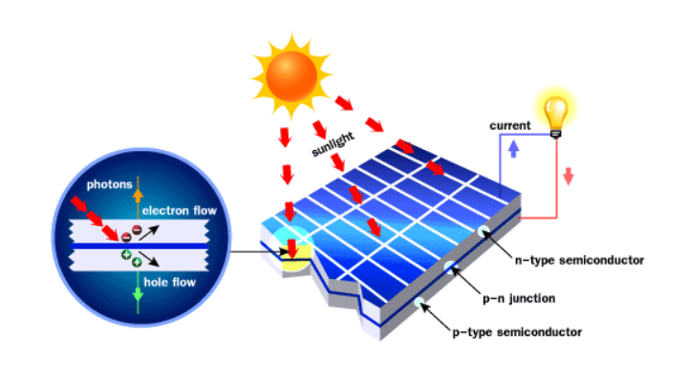
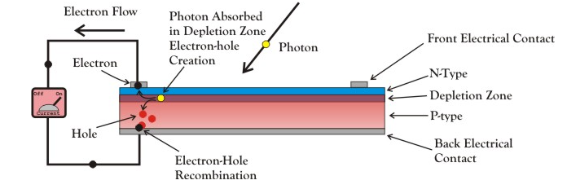
HOW SOLARCELL WORKS??
A solar cell is essential a PN junction with a large surface area.
The N-type material is kept thin to allow light to pass through to the PN junction.

Slide 18
Why PN junction is required for the Solar Cell?
To Enhance the electron-hole recombination
To supress electron-Hole recombination
To Produce more photoelectrons
None of the above
Ans: B

Slide 19
Different types of solar cell

Slide 20
1.Monocrystalline solar cells
Monocrystalline solar cells are made from single crystalline silicon. They are very distinctive in their appearance as they are often coloured, and the cells hold a cylindrical shape. In order to keep the costs low and performance at optimal levels, manufacturers cut out the four sides of the monocrystalline cells. This gives them their recognisable appearance.

Slide 21
2.Polycrystalline Solar Cells
The polycrystalline solar panels were first introduced to the public in 1981. Unlike the monocrystalline cells, polycrystalline ones do not require each of the four sides to be cut. Instead, the silicon is melted and poured into square moulds. These then form perfectly shaped square cells.

Slide 22
3.Thin-film SOLAR CELLS
Thin-film PV cells use amorphous silicon or an alternative to silicon as a semiconductor. These solar cells are relatively flexible and can be directly installed with building materials. They work great even during clouds when there is low sun light. Here, the disadvantage is that thin-film PV Cells comparatively generate less electricity than crystalline silicon cells.

Slide 23
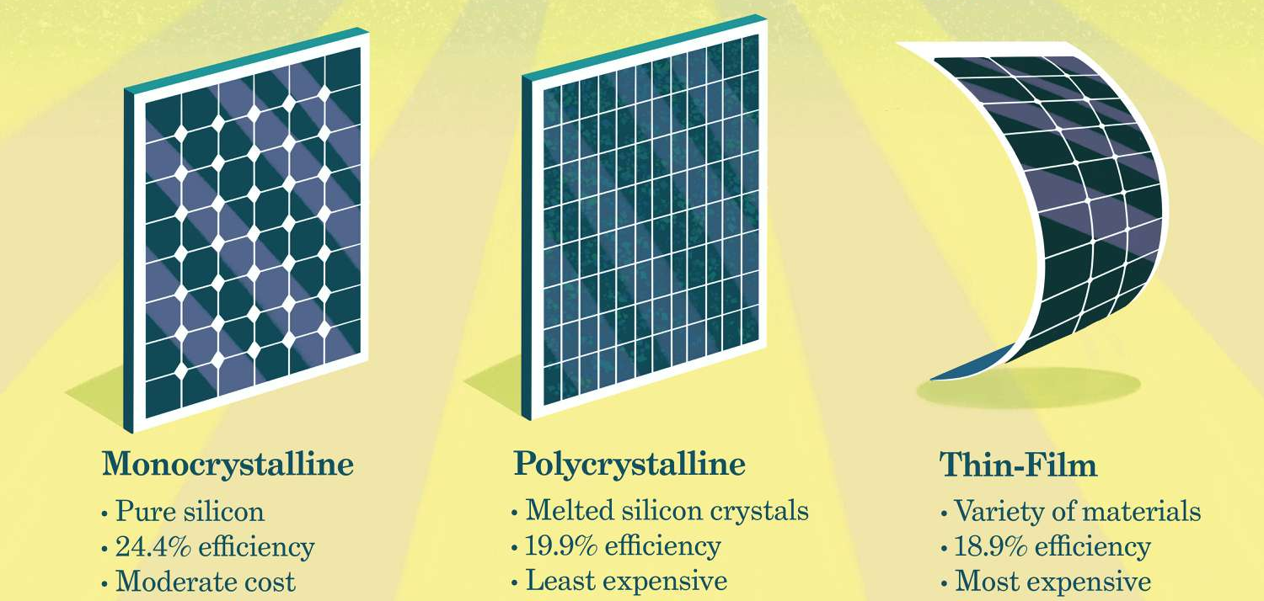

Slide 24
Materials Used in Solar Cell
The materials which are used for this purpose must have band gap close to 1.5ev (827nm). Commonly used materials are-
Silicon.
GaAs.
CdTe.
CuInSe₂

Slide 25
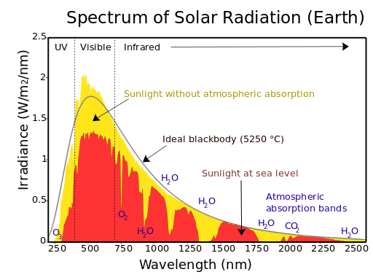
Criteria for Materials to be Used in Solar Cell
Must have band gap from 1ev (1240 nm) to 1.8ev (689 nm).
It must have high optical absorption.
It must have high electrical conductivity.
The raw material must be available in abundance and the cost of the material must be low.

Slide 26

How much Electricity can a PV Cell Generate??
A single photovoltaic cell can produce about 1 to 2 watts of electricity. This energy is too less for use in any household or for a commercial purpose.
In order to increase the output of electricity, several photovoltaic cells are electrically connected together to form a photovoltaic module and these modules are further electrically connected to form a photovoltaic panel / photovoltaic array.
The number of modules connected to form an array depends on the amount of solar electrical energy needed.

Slide 27
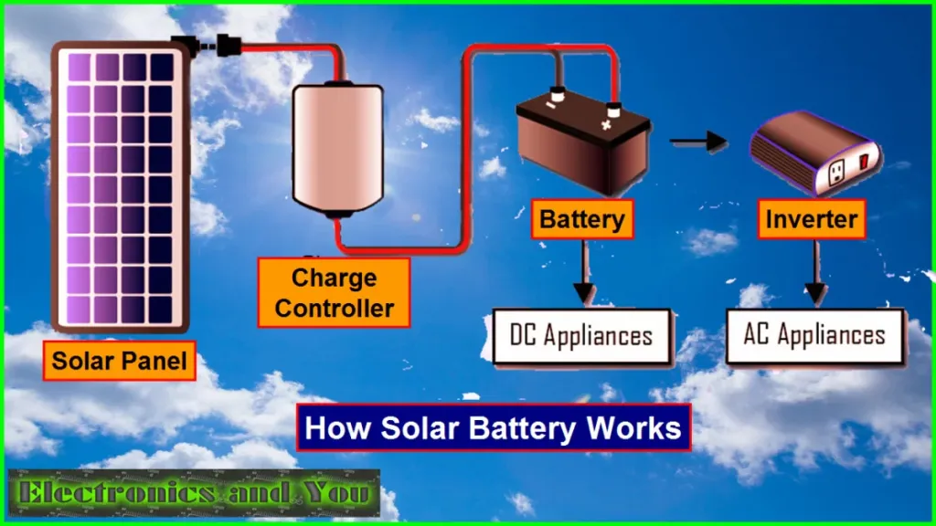
Converting DC to AC Electricity
The PV cells generate DC or direct current. This DC electricity has to be converted to AC or alternating current so that it can be used in a home lighting system or running appliances. An inverter is used to convert DC to AC. This is same as converting DC from a battery to AC.
The electricity generated by solar cells by using solar energy has to be stored so that it can be used later as an when required. This is done by running the current into a bank of Solar Batteries.

Slide 28
Advantages of Solar Cell
It is a renewable source of energy.
Its free of charge.
It doesn’t cause pollution.
They can be use in remote areas.
The system has long life of 10- 15 years or more.
The energy cost is very low because the sources are available freely

Slide 29
Disadvantages of Solar Cell
It needs lots of space.
High initial cost.
No Solar power at night & cloudy days.
Less Solar energy in winter.
DC equipment are expensive

Slide 30
APPLICATIONS OF SOLAR CELL
Its mostly use in the field of toys, watches, etc.
They also use in the field of electric fence.
Its also use in the field of Remote lighting systems area.
This may be use in the field of portable power supplies
They mostly use in the field of satellites.
They also use in the field of water treatment & pumping.
Its may be use in the field of emergency power.

Slide 31
UNIT V: Solid state physics
Free electron theory (Introduction), diffusion and drift current (qualitative); Fermi energy, Fermi-Dirac distribution function; Semiconductors and insulators, Fermi level for intrinsic and extrinsic semiconductors; Band theory of solids -formation of allowed and forbidden energy bands, Concept of effective mass -electrons and holes, Direct and indirect band gap semiconductors; Hall effect (with derivation); basics of Solar cell

Slide 32
PHY110 – ENGINEERING PHYSICS
Text Books: ENGINEERING PHYSICS by HITENDRA K MALIK AND A K SINGH, MCGRAW HILL EDUCATION, 1st Edition, (2009)
References:
ENGINEERING PHYSICS by B K PANDEY AND S CHATURVEDI, CENGAGE LEARNING, 1st Edition, (2009).
ENGINEERING PHYSICS by D K BHATTACHARYA, POONAM TONDON OXFORD UNIVERSITY PRESS.
FUNDAMENTALS OF PHYSICS by HALLIDAY D., RESNICK R AND WALKER J, WILEY, 9th Edition, (2011)

